Slide 1
Group 6
DMT-V

Slide 2
Approach
Problem
Popular MMOs have a mechanic that allows players to form groups and raid dungeons filled with powerful monsters and rare items. However, in these popular games, players need to play for hours and hours, obtaining better items and higher levels, before they can experience this mechanic.
Solution
In our game, players will be able to fight through dungeons with a group of friends from the very beginning.

Slide 3
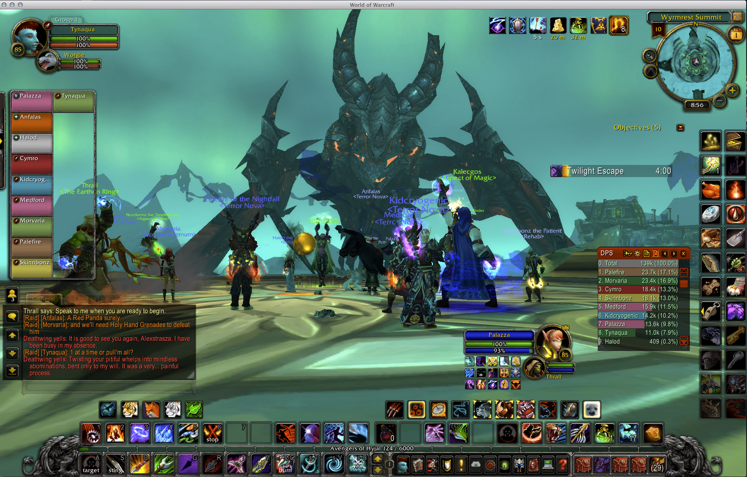
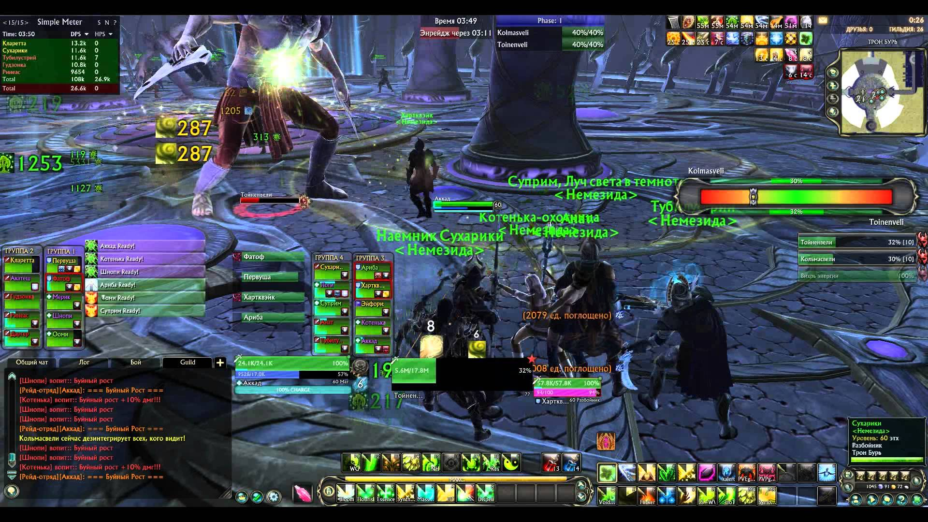
Introduction
Video game that will allow 3 to 5 players to fight AI controlled monsters in a dungeon-like setting.
The game will focus on gameplay over story, providing RPG mechanics to allow the players to imagine their own story.
World of Warcraft (2004) Blizzard Entertainment
Rift (2011) Trion Worlds

Slide 4
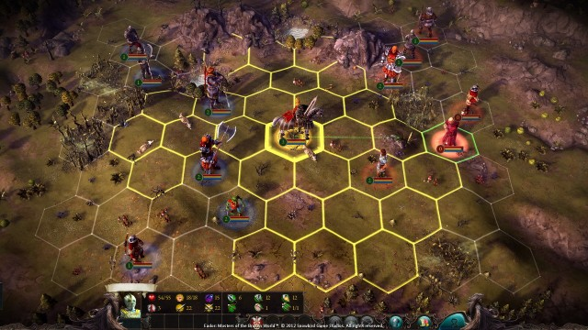
Focus
Gameplay-driven over storyline
Multiplayer over singleplayer
Platform
Desktop, Windows OS (7 and newer)
Genre
Top-Down, Turn-Based, Roguelike, RPG, Dungeon Crawler, Multiplayer, Strategy
Target Audience
Those who enjoy both RPG's and MMO’s raid mechanics
Eador: Masters of the Broken World. (2013). Snowbird Games.

Slide 5
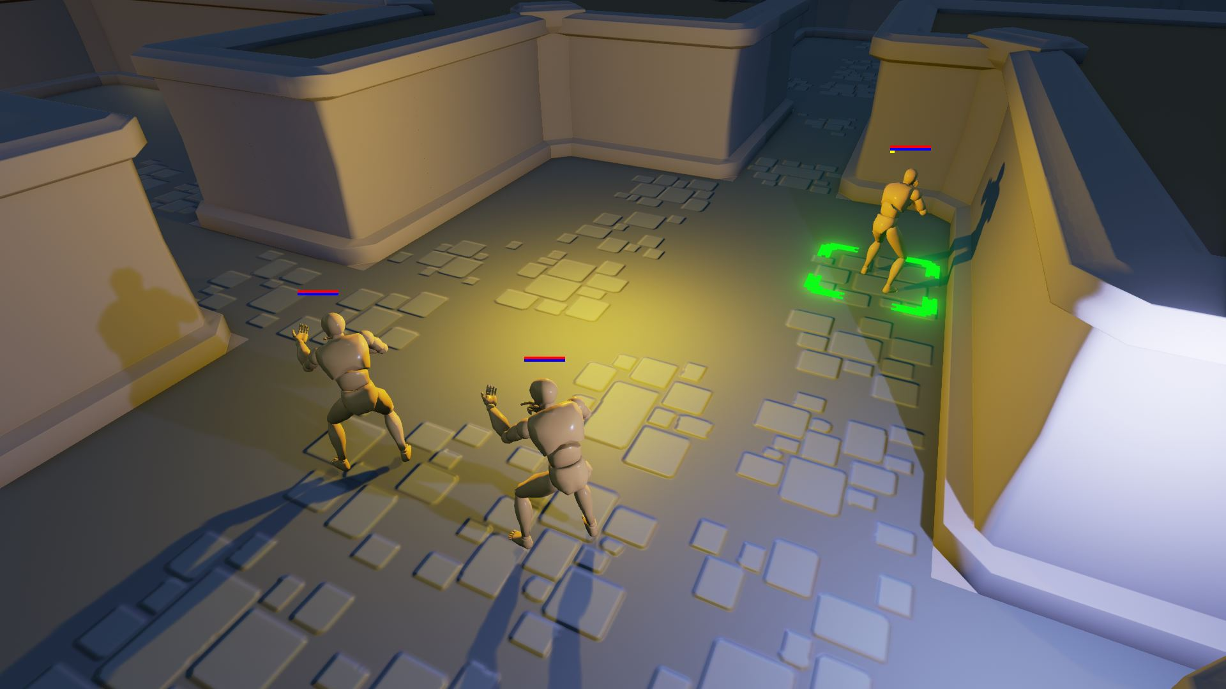
Resources
Unreal Engine 4
C++
Blueprints
Slate UI Framework
Built-in multiplayer capabilities
Blender
Custom textures and design
FL Studios 11
Background music
Turn-Based Strategy. (2016). Epic Games.

Slide 6
Requirement Specification
(Platform) Desktop computer running Windows 7 or newer.
(Process) Use Unreal Engine’s C++ API and Blueprint
(Process) Development in Unreal Editor and Microsoft Visual C++
(Functional) Include multiplayer functionality
(Functional) Be represented in a graphical manner.
(Functional) Player interaction with the game world and other players.

Slide 7
Requirement Specification (continued)
7. (Functional) Save the state of the game.
8. (Functional) Allow users to load a saved game.
9. (Functional) Inventory system with an item database.
10. Functional) Character options depending on their class.
11. (Functional) A turn-based movement and combat system.
12. (Functional) Attribute and skills system.

Slide 8
System Model

Slide 9
Subsystems
Game World
Description: Chess like movement in a closed medieval dungeon setting.
Game Level
Description: Each level will have subsections in which the environment will change. (dungeon to entrance of castle to interior of castle etc)
User Interface - Matthew
Description: The graphical interface that will allow the user to interact with the game.
Game Mode - Matthew
Description: The central hub of the system. It defines the rules for the game and how the other components will interact with one another.

Slide 10
Subsystems (continued)
Item Database - Matthew
Description: A structured list to hold information on all items in the game.
Player Character - Timothy
Description: The character that the user interacts with using the UI. This includes the inventory, equipment, and skills.
Non-Player Character - Timothy
Description: All AI controlled characters within the game.
Game State - David
Description: Holds a record of all important conditions in the game. It will be used to facilitate coordinating multiplayer over internet or LAN.

Slide 11
Risks and Feasibility
Problem
No one in the group has experience making a full video game. This makes it difficult to assess how much can be accomplished in the given time.
Solution
Learning more about video game development from the beginning will help solve problems that may arise due to our lack of experience.

Slide 12
Risks and Feasibility (continued)
Problem
Not all members are experienced with C++, and no member is experienced with Blueprint.
Solution
Many tutorials on C++, very good to learn anyway.
Majority of Unreal Engine can be used with C++, so Blueprint can be learned at a slower pace.

Slide 13
Risks and Feasibility (continued)
Problem
Video game development has many different roles (artists, storyboard writers, animators, etc.) that are not fully present in our team full of programmers.
Solution
Indie game development is well-supported, with many free assets and other resources.
Development will focus on the gameplay instead of story or art.

Slide 14
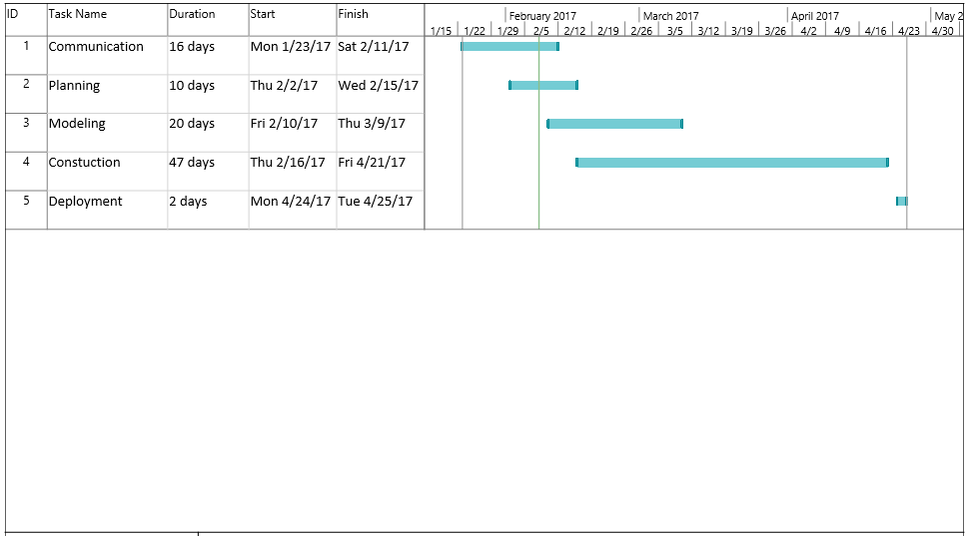
Timeline

Slide 15
Design Decisions
i ) Use a well-established game engine or build backend from scratch.
Existing Game Engine (Unreal Engine 4)
+Overall less time spent coding the backend.
+Less risks using an established game engine that is known to work.
+A standard engine will allow other people to contribute to the open-source project.
-Learning how to use the game engine will take time.
Building Our Own
+More control over how the game will function.
-Problems may arise when attempting to synchronize the game engine with other components.
-Planning other parts of the game will need to wait until the engine is fully mapped out.

Slide 16
Design Decisions (continued)
ii) Choosing to focus on the gameplay rather than the story.
Gameplay-Driven
+Narrative exposition can be implicitly told through the gameplay (e.g., environment, characters, enemies, etc.).
+Mechanics are more important to the game’s genre, warranting majority of our focus.
-Gameplay can become repetitive and stale; without a story, there will be nothing “new” after a few hours of gameplay.
Story-Driven
+A compelling story might interest more people.
+Many examples are available for medieval fantasy stories.
-A story can limit our options when designing the game.

Slide 17
Design Decisions (continued)
iii) Turn-based system instead of free-roam system
Turn-Based
+Easier to synchronize multiplayer.
+Inherently adds a strategic element to the game.
+Active movement in the game can be synthesized with motion in the gameworld.
-Players may get bored if a teammate is taking too long with their turn.
Free Roam
+The combat and movement system would be more exciting, if done properly.
-Planning, resource, and programming intensive for the movement system and other various animations.
-Without restricted movements, players can encounter bugs more frequently.
-Balancing will be harder to accomplish if the combat is not limited in some way.

